Slide 1
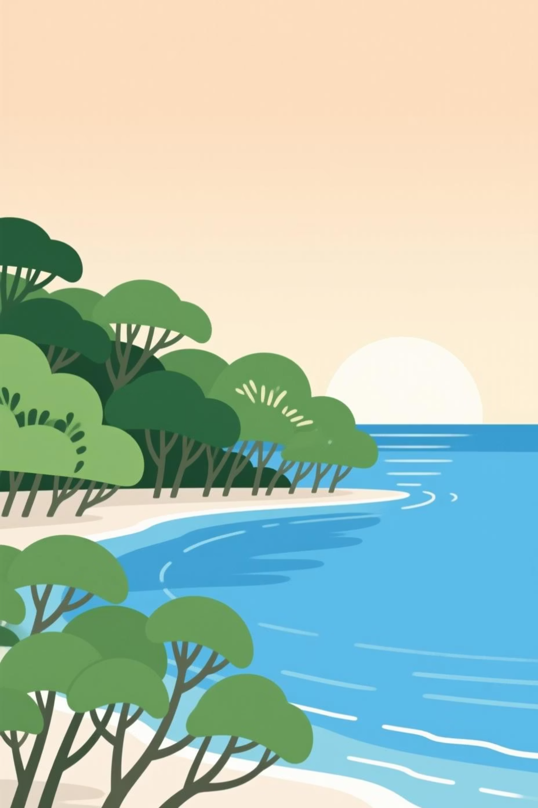
Community Blue Carbon Platform
Empowering Coastal Communities to Protect Blue Carbon Ecosystems

Slide 2

The Alarming Decline of Our Coastal Treasures
1.5%
30-50%
Seagrass Loss Per Year
Mangrove Forest Decline
Approximately 30% of historical global coverage already lost.
Over the past half-century, vast areas have disappeared.
These losses equate to significant CO₂ emissions and reduced natural defenses for vulnerable coastlines.

Slide 3


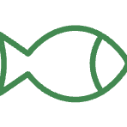

Why Blue Carbon Matters: More Than Just Carbon
Climate Mitigation
Coastal Protection
Powerful CO₂ removal and long-term storage.
Natural buffers against storms, floods, and erosion.
Biodiversity Hotspots
Community Livelihoods
Crucial nurseries and habitats for marine life.
Supports fisheries, tourism, and protects infrastructure.

Slide 4




Our Solution: The Community Blue Carbon Platform
A mobile-friendly web platform designed to engage and empower local communities to become guardians of their coastal ecosystems.
Community Reporting
Live Impact Map
Photo-based reporting of local activities.
Real-time visualization of coastal actions.
Gamification
Education Hub
Rewards and recognition for active participation.
Spreading awareness and knowledge.

Slide 5
Core Features: Driving Action Through Innovation
Reporting System
Live Impact Map
Upload photos with GPS auto-capture.
Interactive map with color-coded pins (green/red).
Categorize actions: planting, destruction, restoration.
Filter by date, type, and location.
Assess impact and add descriptions.
Click to view detailed reports.
Gamification & Rewards
Education & Calculator
Points for verified reports, leaderboards.
Simple facts and local success stories.
Badges for milestones (e.g., Ocean Guardian).
Blue Carbon Calculator: visualize CO₂ impact.
Monthly challenges to foster engagement.
Personal and community impact dashboards.

Slide 6





User Journey: Community-Powered Conservation
1. Community Engagement
Local members identify an activity or change in blue carbon ecosystems.
2. Report Upload
User captures photos and details via the platform, with automatic GPS tagging.
3. Map Visualization
The action appears instantly on the live impact map, updating the community view.
4. Gamification & Impact
Users earn points/badges, and the action's CO₂ impact is calculated, fostering a sense of achievement.
5. Policy & Awareness
Collected data empowers NGOs and government for informed action and raises local awareness.

Slide 7
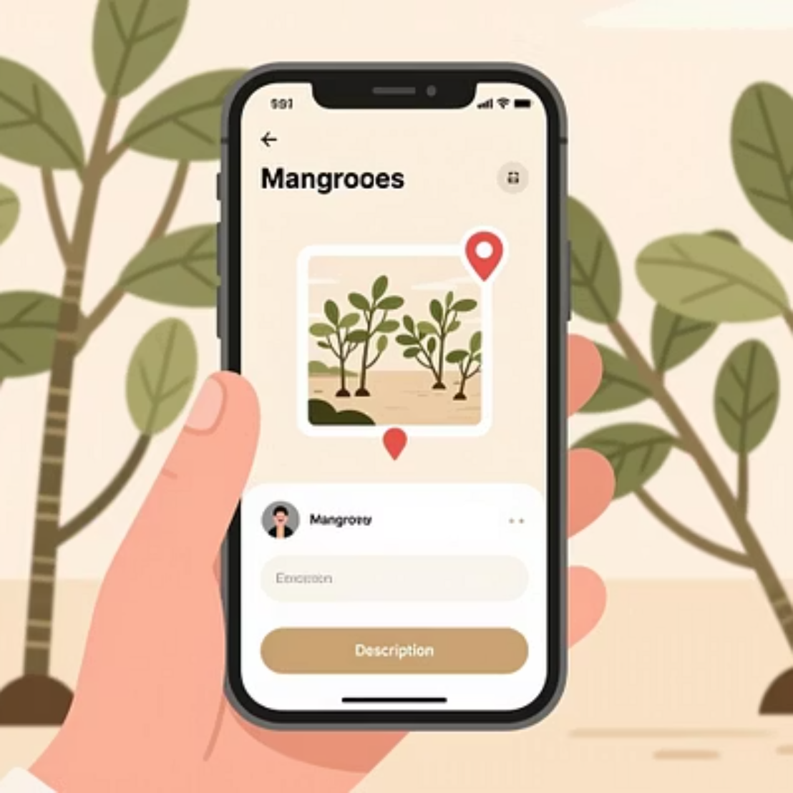
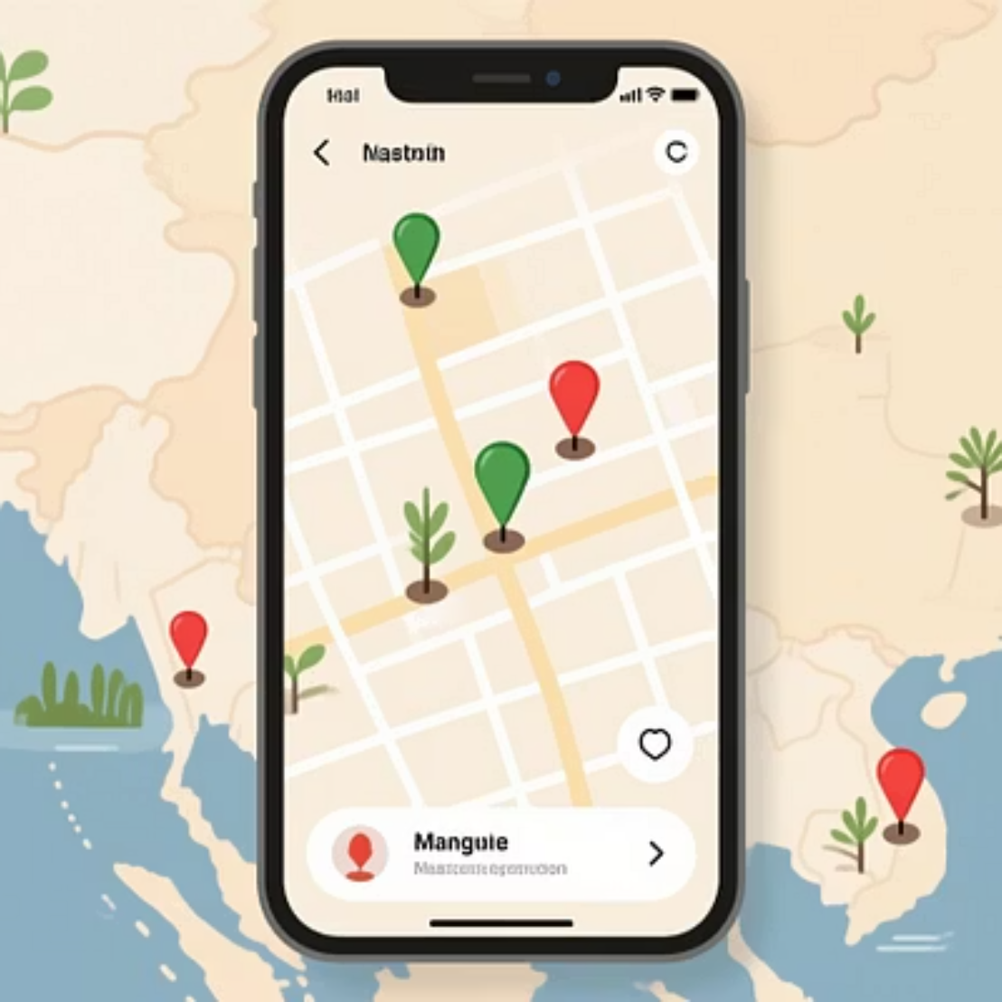
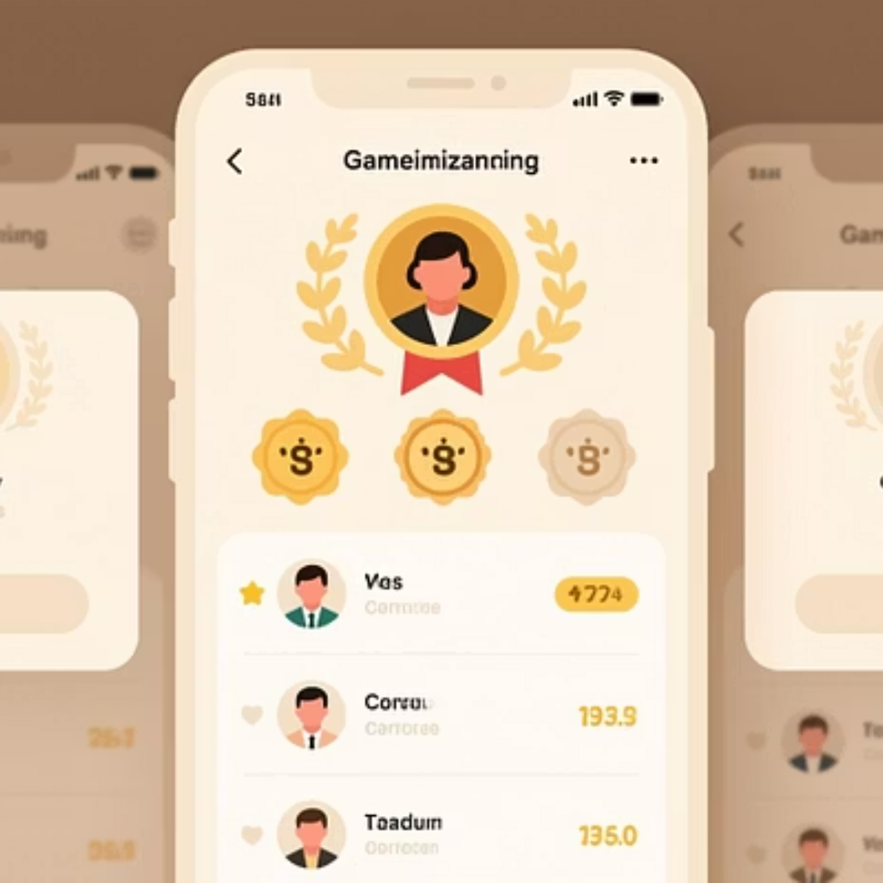
Platform in Action: Prototype Screenshots
Our intuitive interface makes reporting easy, bringing coastal conservation to everyone's fingertips.

Slide 8
Impact Story: A Fisher's Contribution
"A fisher reports mangrove plantation on the platform."
— The app records the activity with GPS and photos, instantly adding it to the live impact map.
"The new plantation appears on the map."
— This transparency allows local authorities and NGOs to verify and monitor restoration efforts.
"The action saves an estimated 200kg of CO₂."
— The Blue Carbon Calculator quantifies the environmental benefit, reinforcing the user's impact.
"The fisher earns a 'Coastal Champion' badge, inspiring the community."
— Recognition motivates continued participation and fosters a sense of collective responsibility, driving further conservation.

Slide 9
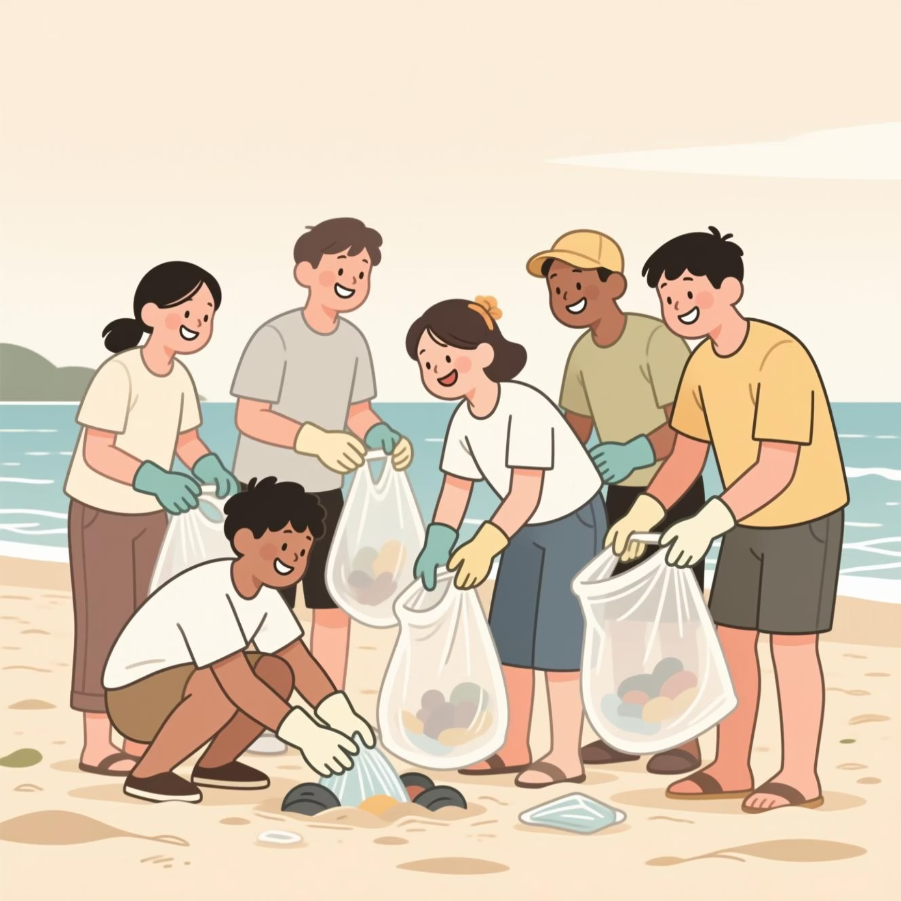
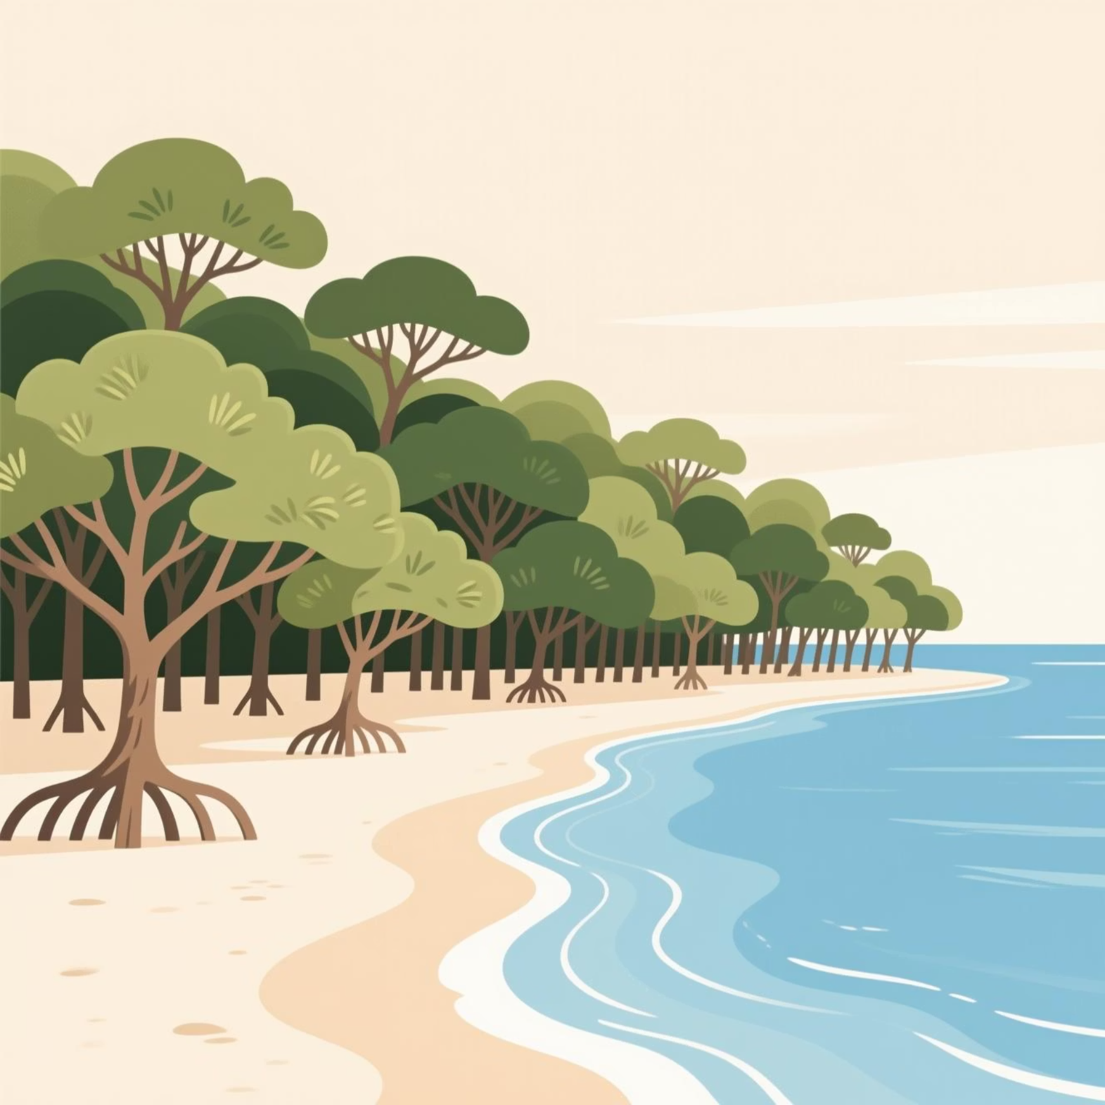
Expected Impact: Short-Term vs. Long-Term
Short-Term (Next 3 Months)
Long-Term (12+ Months)
User Adoption: Onboard 500+ active community members.
Partnerships: Secure collaborations with 5+ NGOs and government agencies.
Reports: Generate 1,000+ verified blue carbon reports.
Conservation: Achieve measurable gains in coastal ecosystem health.
Awareness: Increase local blue carbon awareness by 25%.
Policy Influence: Contribute data for informed policy development.

Slide 10
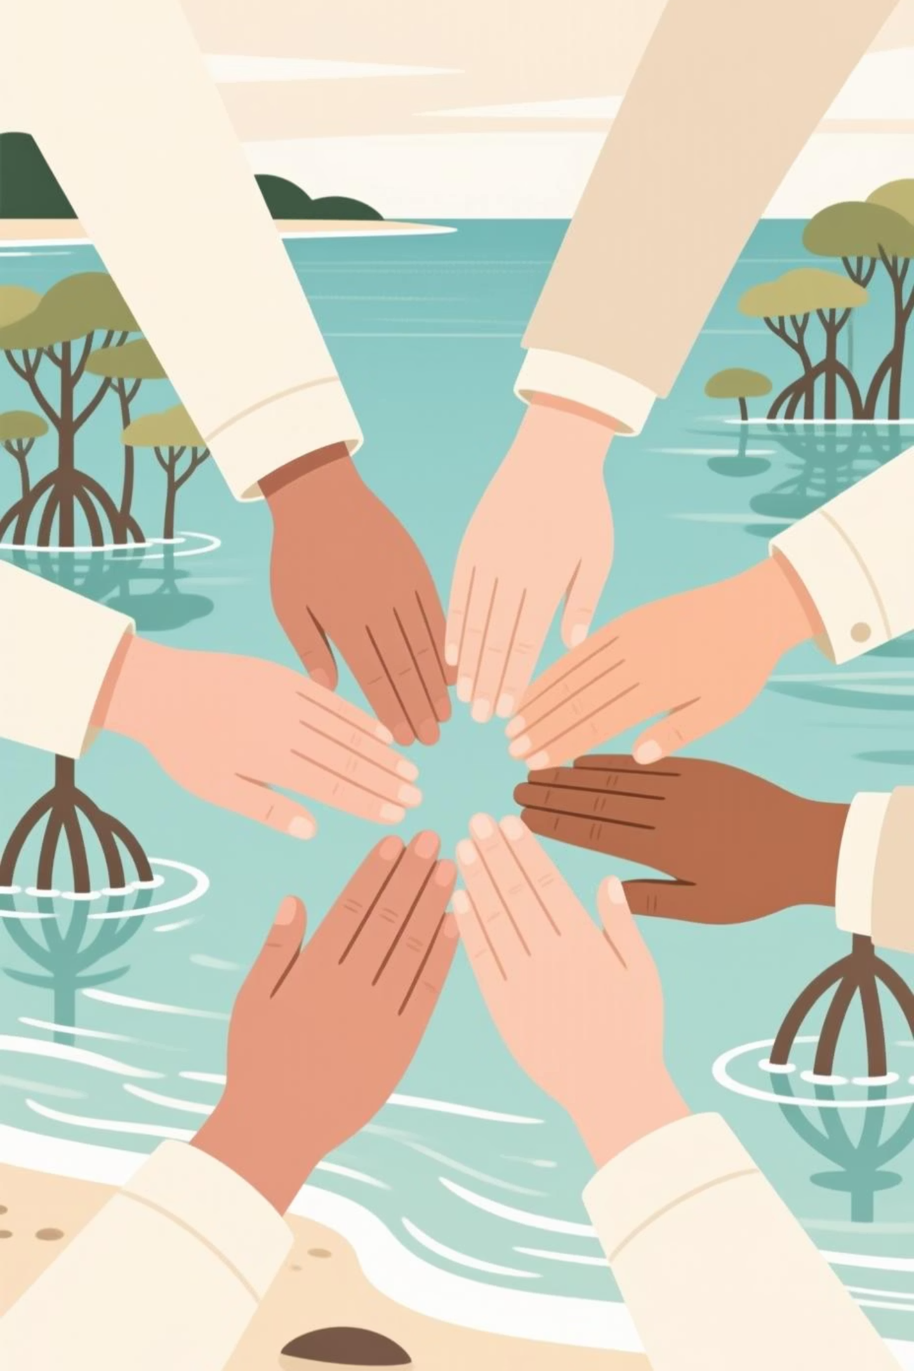
Thank You!
Join us in protecting coasts & climate.
For more information, visit our website or connect with us:
[Your Website] | [Social Media Handles] | [Contact Email]

